Slide 1
Transformers

Slide 2
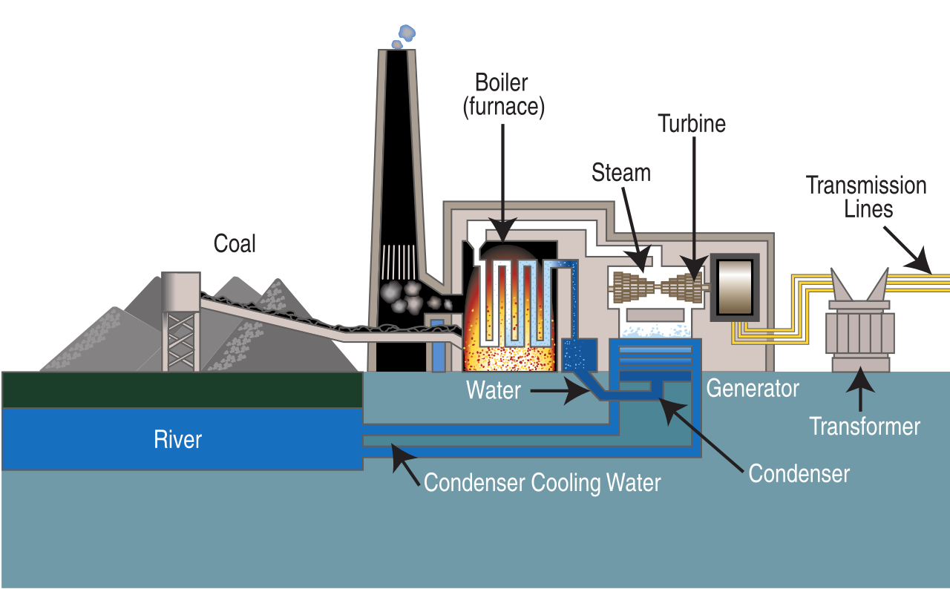
Diagram of a Power Generating station and Transformer

Slide 3
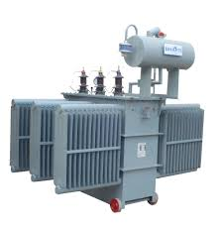
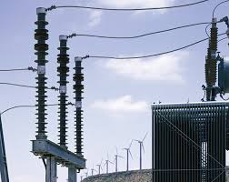
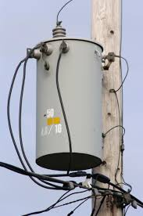
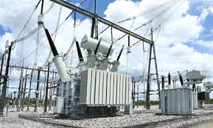
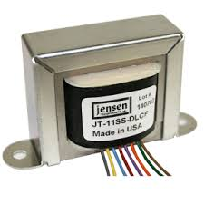
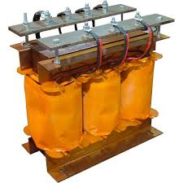
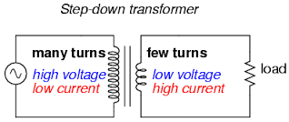
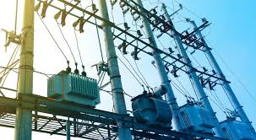
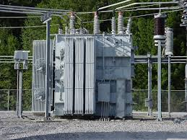
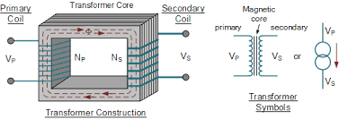
Pictorial diagram of different types of transformers

Slide 4
Transformer
An A.C. static device used to change low voltage/high voltage A.C. system into high voltage/low voltage A.C. system without changing the frequency at almost 100% efficiency.
In brief,
1. Transfers electric power from one circuit to another without any electrical connection
2. It does so without a change of frequency
3. It accomplishes this by electromagnetic induction
4. Where the two electric circuits are in mutual inductive influence of each other.

Slide 5
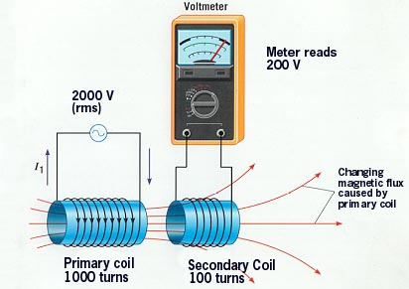
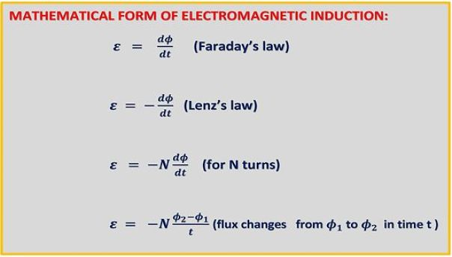
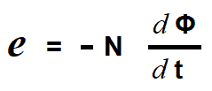
Principle of operation
It is based on principle of MUTUAL INDUCTION. An e.m.f. is induced in a coil when flux in the neighbouring coil changes.

Slide 6
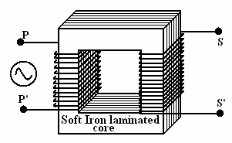
Working principle of a transformer
1. When current in the primary coil changes being alternating in nature, a changing magnetic field is produced
2. This changing magnetic field gets associated with the secondary through the soft iron core
3. Hence magnetic flux linked with the secondary coil changes.
4. Which induces e.m.f. in the secondary.

Slide 7
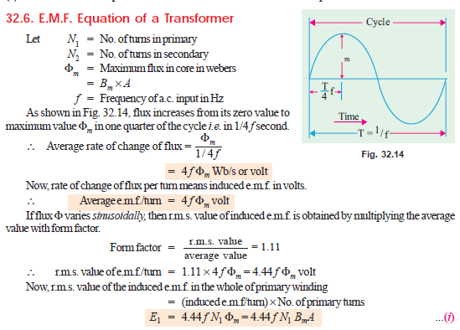
EMF equation of a transformer

Slide 8
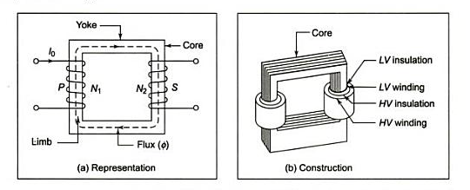
Core type
Windings are wrapped around two sides of a laminated square core.

Slide 9
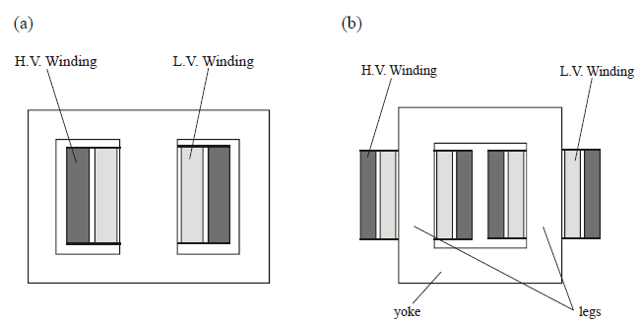
Sectional view of transformers
Note:
High voltage conductors are smaller cross section conductors than the low voltage coils (why??)

Slide 10
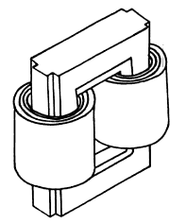
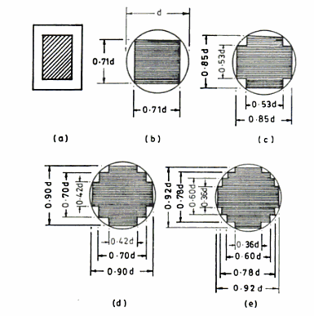
Core type
Fig1: Coil and laminations of core type transformer
Fig2: Various types of cores

Slide 11
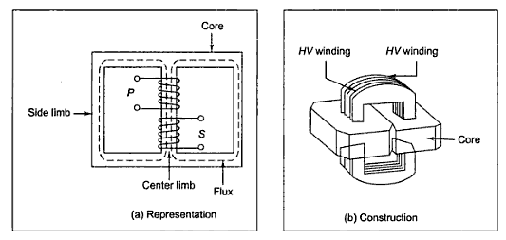
Constructional detail : Shell type
Windings are wrapped around the center leg of a laminated core.

Slide 12
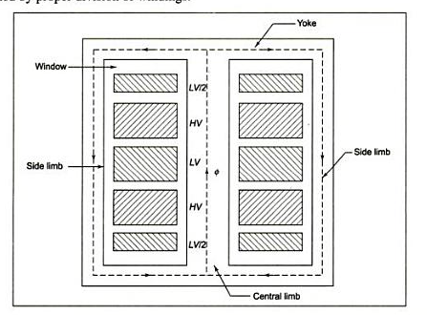
Shell type
The HV and LV windings are split into no. of sections
Where HV winding lies between two LV windings
In sandwich coils leakage can be controlled
Fig: Sandwich windings

Slide 13
Ideal Transformers
Zero leakage flux:
-Fluxes produced by the primary and secondary currents are confined within the core
The windings have no resistance:
- Induced voltages equal applied voltages
The core has infinite permeability
- Reluctance of the core is zero
- Negligible current is required to establish magnetic flux
Loss-less magnetic core
- No hysteresis or eddy currents

Slide 14
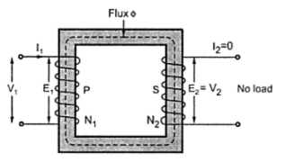
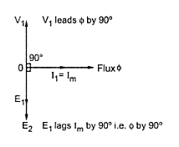
Ideal transformer
V₁ – supply voltage ; I₁- noload input current ;
V₂₋ output voltgae; I₂- output current
I_{m}- magnetising current;
E₁-self induced emf ; E₂- mutually induced emf

Slide 15
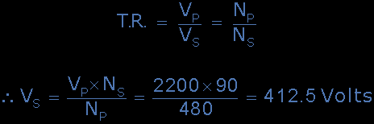

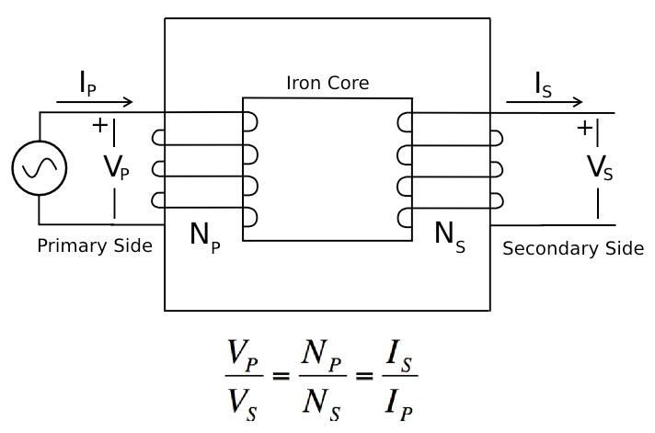
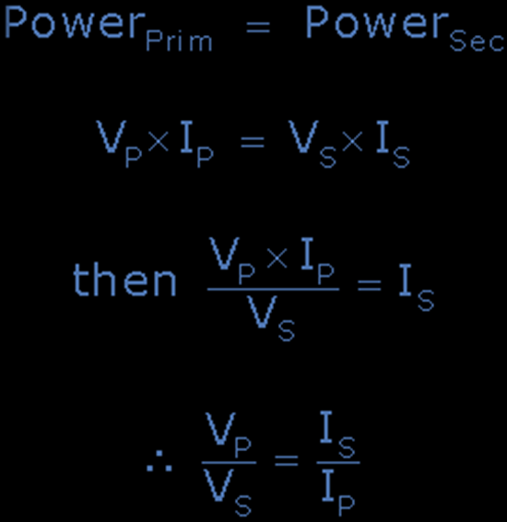

Slide 16
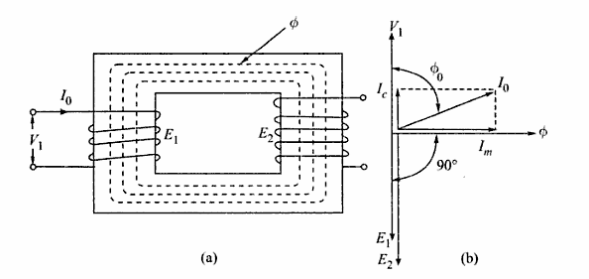
Phasor diagram: Transformer on No-load

Slide 17
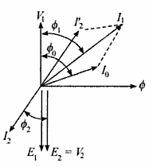
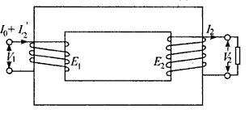
Transformer on load assuming no voltage drop in the winding
Fig shows the Phasor diagram of a transformer on load by assuming
No voltage drop in the winding
Equal no. of primary and secondary turns

Slide 18
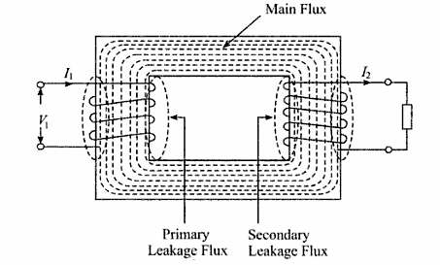
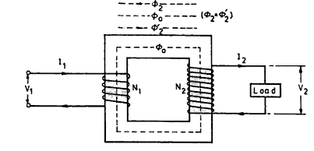
Transformer on load
Fig. a: Ideal transformer on load
Fig. b: Main flux and leakage flux in a transformer

Slide 19
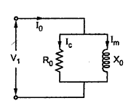


Equivalent circuit of a transformer
No load equivalent circuit:

Slide 20
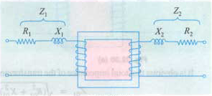
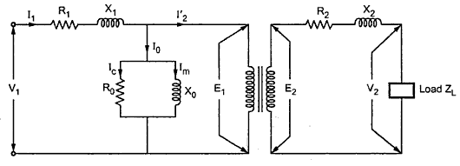
Equivalent circuit parameters referred to primary and secondary sides respectively

Slide 21
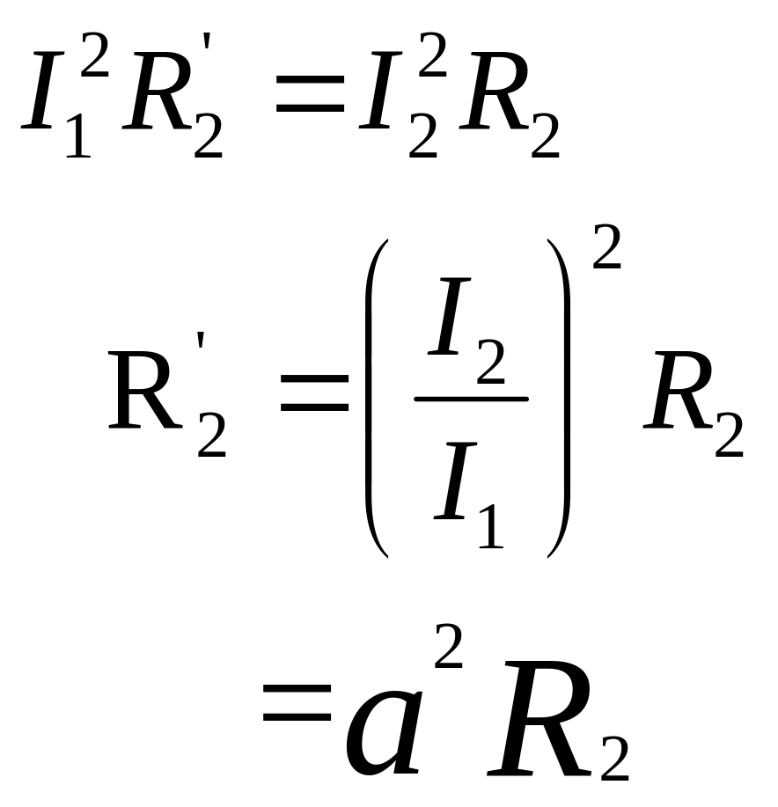
The effect of circuit parameters shouldn’t be changed while transferring the parameters from one side to another side
It can be proved that a resistance of R₂ in sec. is equivalent to R₂/k² will be denoted as R₂’(ie. Equivalent sec. resistance w.r.t primary) which would have caused the same loss as R₂ in secondary,
a =N₁/N₂ =Turns ratio

Slide 22
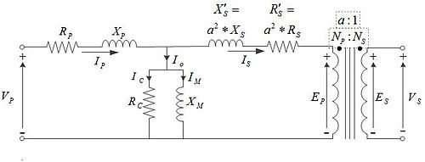
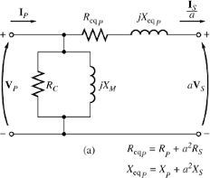
Transferring secondary parameters to primary side
a =N_{p}/N_{s} =Turns ratio

Slide 23
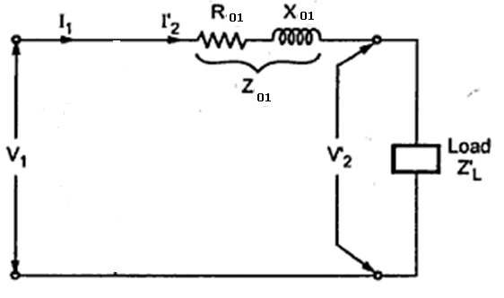
Approximate equivalent circuit
Since the noload current is 1% of the full load current, the nolad circuit can be neglected

Slide 24
Transformer Tests
The performance of a transformer can be calculated on the basis of equivalent circuit
The four main parameters of equivalent circuit are:
- R₀₁ as referred to primary (or secondary R₀₂)
- the equivalent leakage reactance X₀₁ as referred to primary (or secondary X₀₂)
- Magnetising susceptance B₀ ( or reactance X₀)
- core loss conductance G₀ (or resistance R₀)
The above constants can be easily determined by two tests
- Oper circuit test (O.C test / No load test)
- Short circuit test (S.C test/Impedance test)
These tests are economical and convenient
- these tests furnish the result without actually loading the transformer
Electrical Machines

Slide 25
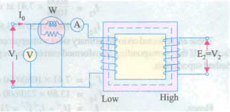
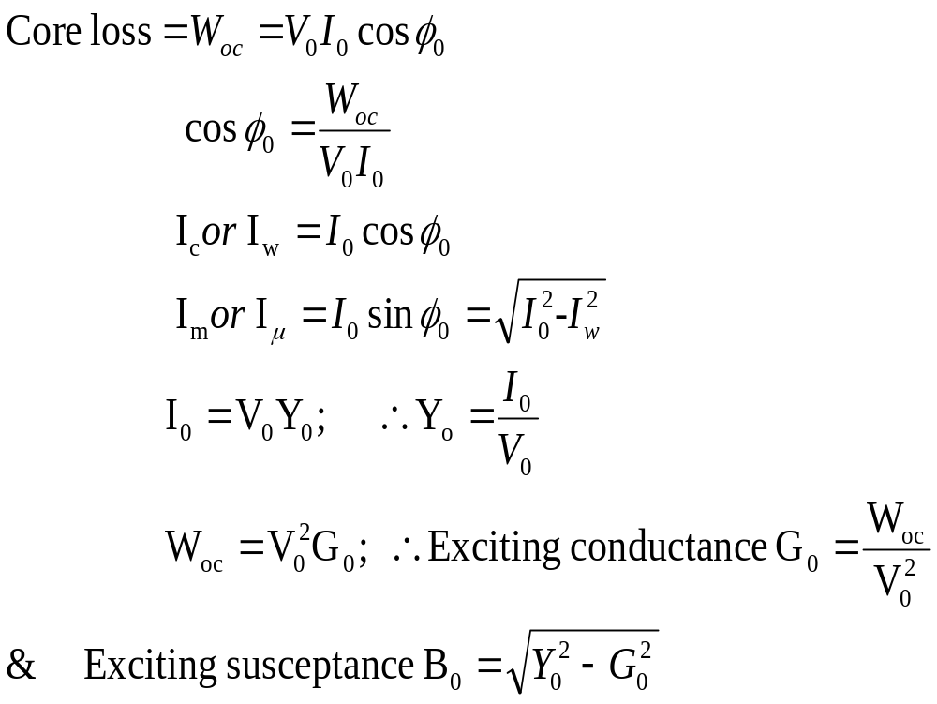
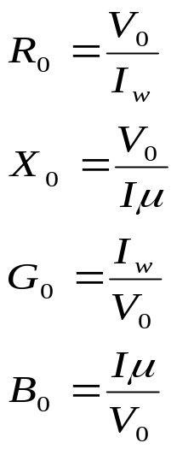
Open-circuit Test
In Open Circuit Test the transformer’s secondary winding is open-circuited, and its primary winding is connected to a full-rated line voltage.
Usually conducted on H.V side
To find
(i) No load loss or core loss
(ii) No load current I_{o} which is helpful in finding G_{o}(or R_{o} ) and B_{o} (or X_{o} )

Slide 26
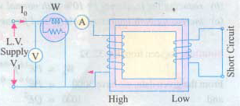
Short-circuit Test
In Short Circuit Test the secondary terminals are short circuited, and the primary terminals are connected to a fairly low-voltage source
The input voltage is adjusted until the current in the short circuited windings is equal to its rated value. The input voltage, current and power is measured.
Usually conducted on L.V side
To find
(i) Full load copper loss – to pre determine the efficiency
(ii) Z₀₁ or Z₀₂; X₀₁ or X₀₂; R₀₁ or R₀₂ - to predetermine the voltage regulation

Slide 27
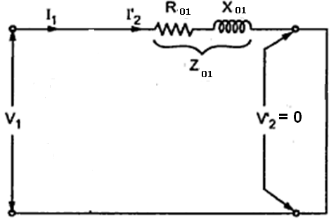
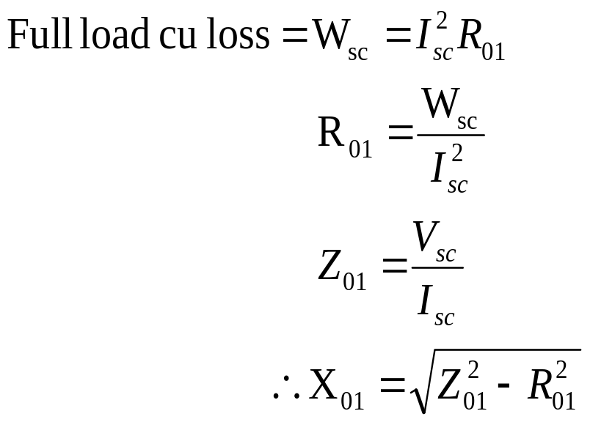
Contd…

Slide 28
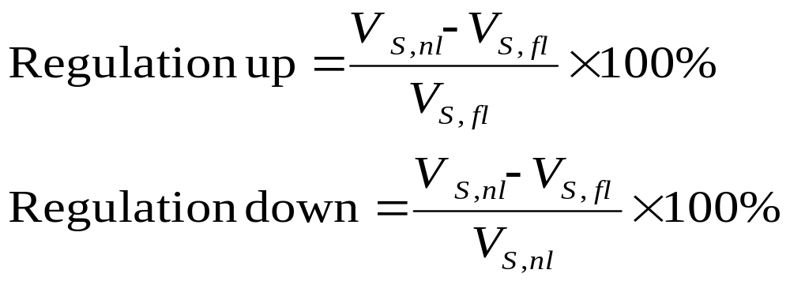
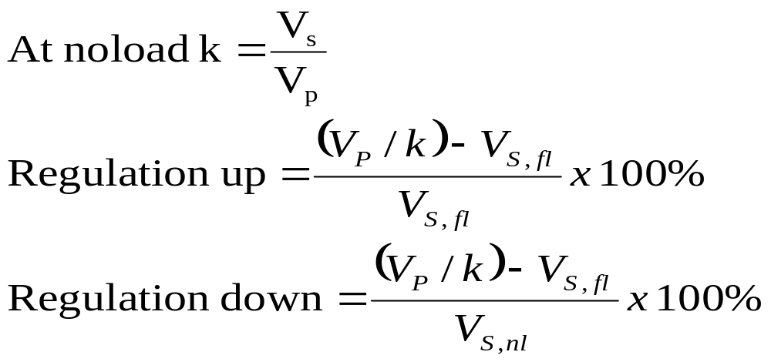
Transformer Voltage Regulation and Efficiency
The output voltage of a transformer varies with the load even if the input voltage remains constant. This is because a real transformer has series impedance within it. Full load Voltage Regulation is a quantity that compares the output voltage at no load with the output voltage at full load, defined by this equation:
Ideal transformer, VR = 0%.
Electrical Machines

Slide 29
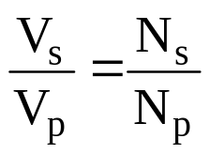
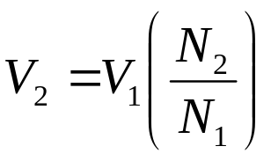
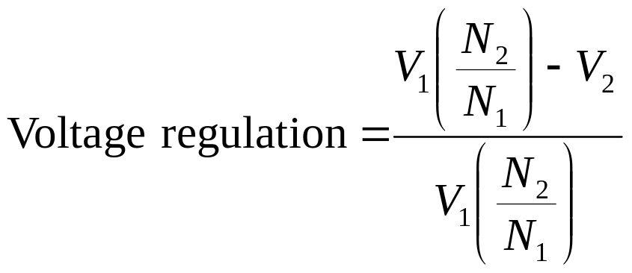
Voltage regulation of a transformer
recall
Secondary voltage on no-load
V₂ is a secondary terminal voltage on full load
Substitute we have

Slide 30


Transformer Phasor Diagram
To determine the voltage regulation of a transformer, it is necessary understand the voltage drops within it.
Electrical Machines
© Aamir Hasan Khan

Slide 31

Transformer Phasor Diagram
Ignoring the excitation of the branch (since the current flow through the branch is considered to be small), more consideration is given to the series impedances (R_{eq} +jX_{eq}).
Voltage Regulation depends on magnitude of the series impedance and the phase angle of the current flowing through the transformer.
Phasor diagrams will determine the effects of these factors on the voltage regulation. A phasor diagram consist of current and voltage vectors.
Assume that the reference phasor is the secondary voltage, V_{S}. Therefore the reference phasor will have 0 degrees in terms of angle.
Based upon the equivalent circuit, apply Kirchoff Voltage Law,
Electrical Machines
© Aamir Hasan Khan

Slide 32

Transformer Phasor Diagram
For lagging loads, the vertical components of R_{eq} and X_{eq} will partially cancel each other. Due to that, the angle of V_{P}/a will be very small, hence we can assume that V_{P}/k is horizontal. Therefore the approximation will be as follows:
Electrical Machines

Slide 33

Formula: voltage regulation

Slide 34



Transformer Efficiency
Transformer efficiency is defined as (applies to motors, generators and transformers):
Types of losses incurred in a transformer:
  Copper I²R losses
  Hysteresis losses
  Eddy current losses
Therefore, for a transformer, efficiency may be calculated using the following:
Electrical Machines

Slide 35


Losses in a transformer
Core or Iron loss:
Copper loss:

Slide 36

Condition for maximum efficiency

Slide 37

Contd.,
The load at which the two losses are equal =

Slide 38

All day efficiency
All day efficiency is always less than the commercial efficiency

Slide 39


Slide 40

Application of transformer in a typical Power Supply for electronics circuit
The input is the 230 volt 50 Hz AC supply.
The power supply converts the AC into DC and provides one or more DC output voltages.
Some modern electronic circuits need two or more different voltages.
Common voltages are 48, 24, 15, 12, 9, 5, 3.3, 2.5, 1.8, 1.5, 1.2 and 1 volts.
A good example of a modern power supply is the one inside a PC that furnishes 12, 5, 3.3 and 1.2 volts.
Notes:
_{<number>}

